Slide 1

COM 316 ARTIFICIAL INTELLIGENCE AND EXPERT SYSTEMS
Lecture 01
Introduction
Lecturer: T.Njoroge

Slide 2
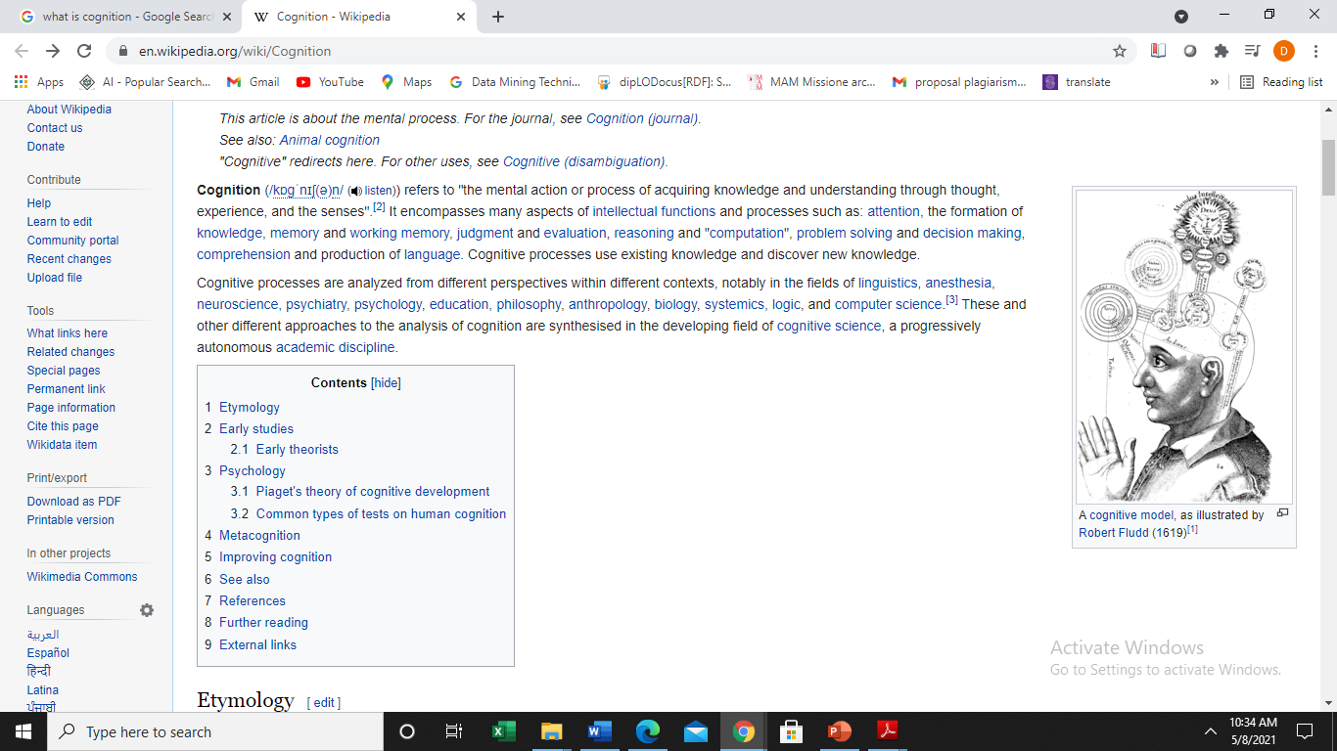
Cognitive
Cognitive comes from the latin word cognito, which means to apprehend or understand
Lecturer: T.Njoroge

Slide 3
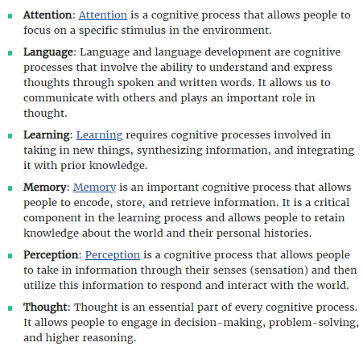
Cognition
Cognition comes from the Latin word cognoscere which means “get to know”.
It refers to all mental processes (techniques) that are used by people to be aware of and understand the world.
Examples
Lecturer: T.Njoroge

Slide 4
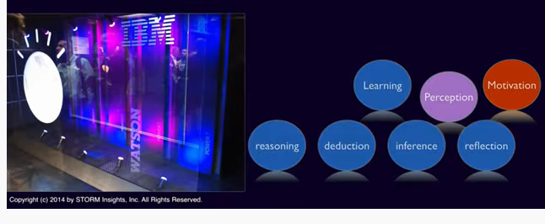
Cognitive Computing
Cognitive Computing is a problem-solving approach that uses hardware or software to automate the function of natural cognitive processes in complex situations where the answers may be ambiguous and uncertain
Lecturer: T.Njoroge

Slide 5
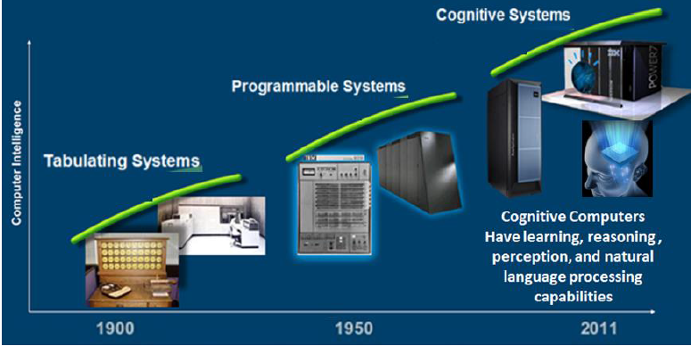
Evolution of cognitive systems
Cognitive systems have evolved from programmed and tabulating systems
Lecturer: T.Njoroge

Slide 6
Evolution of Computing Systems
Tabulating era existed in early 1900
It was characterized by use of 1900 calculators and tabulating machines made of mechanical systems, and later made of vacuum tubes.
In this era the numbers were fed in on punch cards, and there was no extraction of the data itself.
Lecturer: T.Njoroge

Slide 7
Programmable era of computing
Programmable era of computing, which started in the 1940s and computing was completely controlled by the programming provided to the system.
Tools used raged from vacuum tubes to microprocessors.
It consisted of taking processes and putting them into the machine.
Lecturer: T.Njoroge

Slide 8
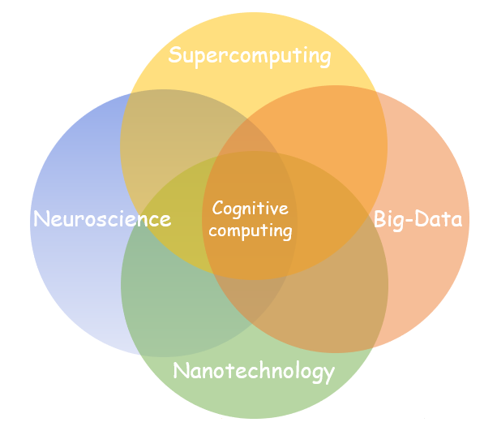
Cognitive computing era
Cognitive computing era, represented by the intersection between neuroscience, supercomputing, nanotechnology and big data
Lecturer: T.Njoroge

Slide 9
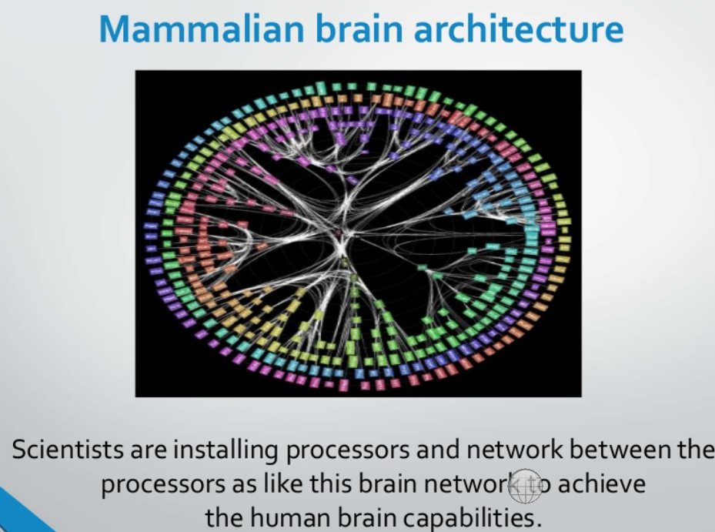
Cognitive computing era
Neuroscience deals with the study of neural systems or mind
The architecture of the cognitive computing devices is the same as the architecture of brain
The devices based on this architecture consist of the electronic neurons and synapse and are called neurosynaptic chips
The inner network is like brain network
Example
Lecturer: T.Njoroge

Slide 10
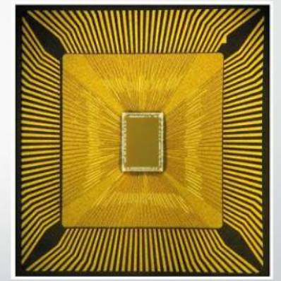
Cognitive computing era
Nano Technology is the science in which material size of 10 to the
Power of -9
It is used to embed large number of processors and synapse to build the system like the human brain.
Example: IBM has developed cognitive chips called IBM’s “Neurosynaptic” using nanotechnology
The chip has 4096 cores, 1 million neurons, 5.4 billion transistors
Lecturer: T.Njoroge

Slide 11
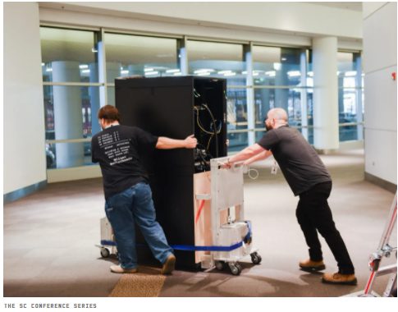
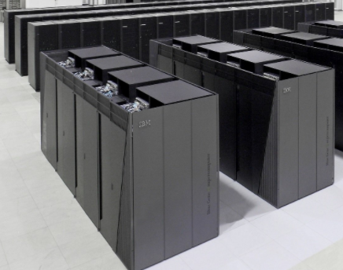
Cognitive computing era
Super computing is the science of developing high performance computers to mimic our brain that has high performance capacity
As the same as supercomputers the performance of the cognitive computing devices is calculated in terms of floating point operations per seconds(FLOPS)
Examples of Supercomputers
Lecturer: T.Njoroge

Slide 12
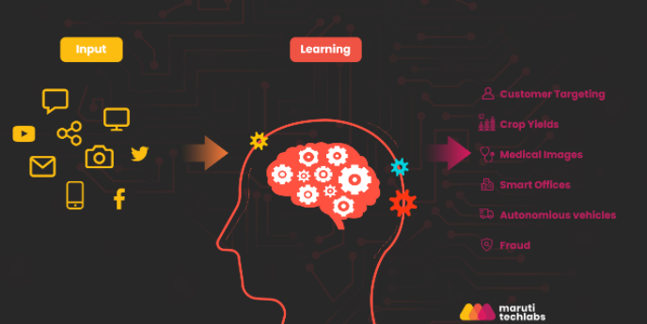
Goal of Cognitive Computing
The goal of cognitive computing is to simulate and improve natural cognitive processes (Learning, perception, deduction etc) in a computerized model.
That is, to mimic the way the human brain works.
Lecturer: T.Njoroge

Slide 13
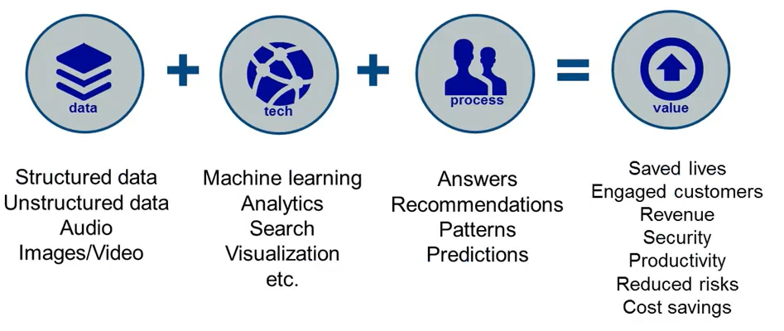
Cognitive computing framework
Cognitive computing framework has three main components of Cognitive Computing systems
Input
Cognition
Output
Goal
Lecturer: T.Njoroge

Slide 14
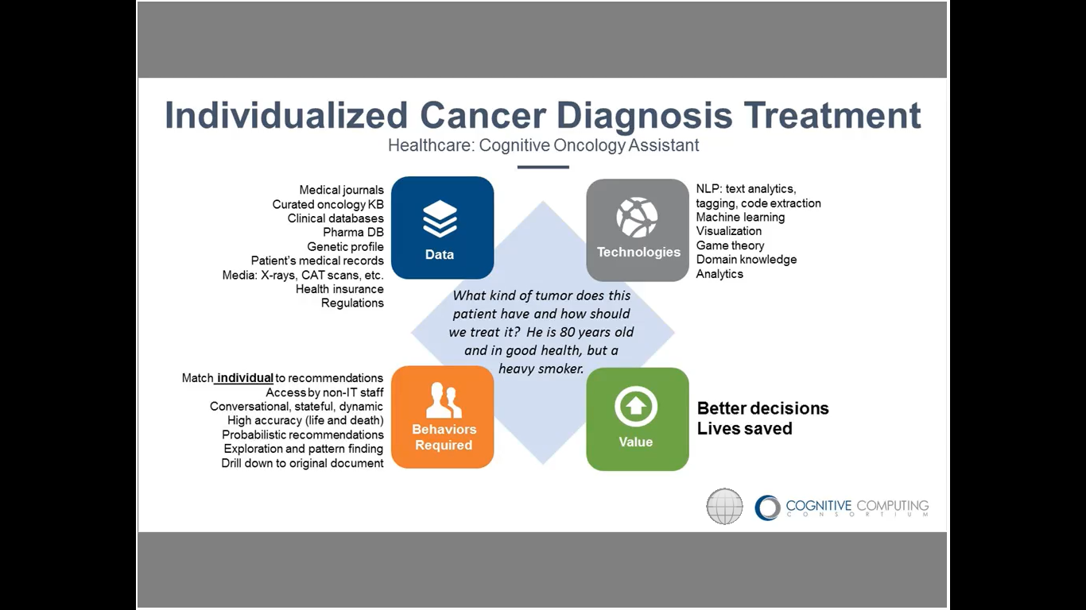
Cognitive computing framework
Example
Lecturer: T.Njoroge

Slide 15
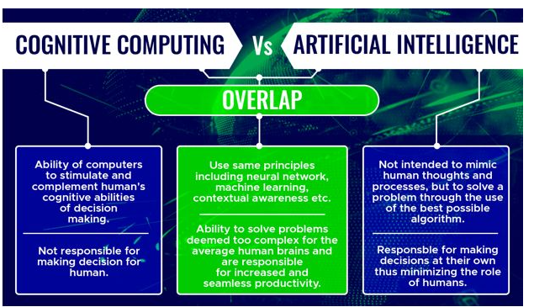
Cognitive Computing versus AI
Lecturer: T.Njoroge

Slide 16
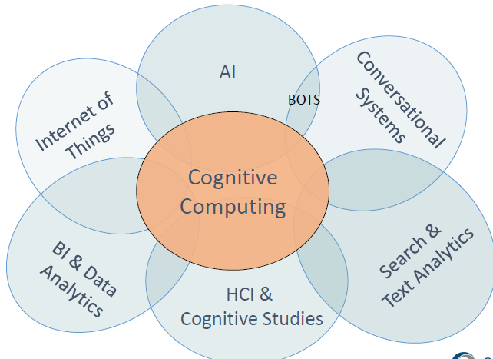
Contributing Technologies
https://www.slideshare.net/diannepatricia/understanding-cognitive-applications-a-framework-sue-feldman?from_action=save
Lecturer: T.Njoroge

Slide 17
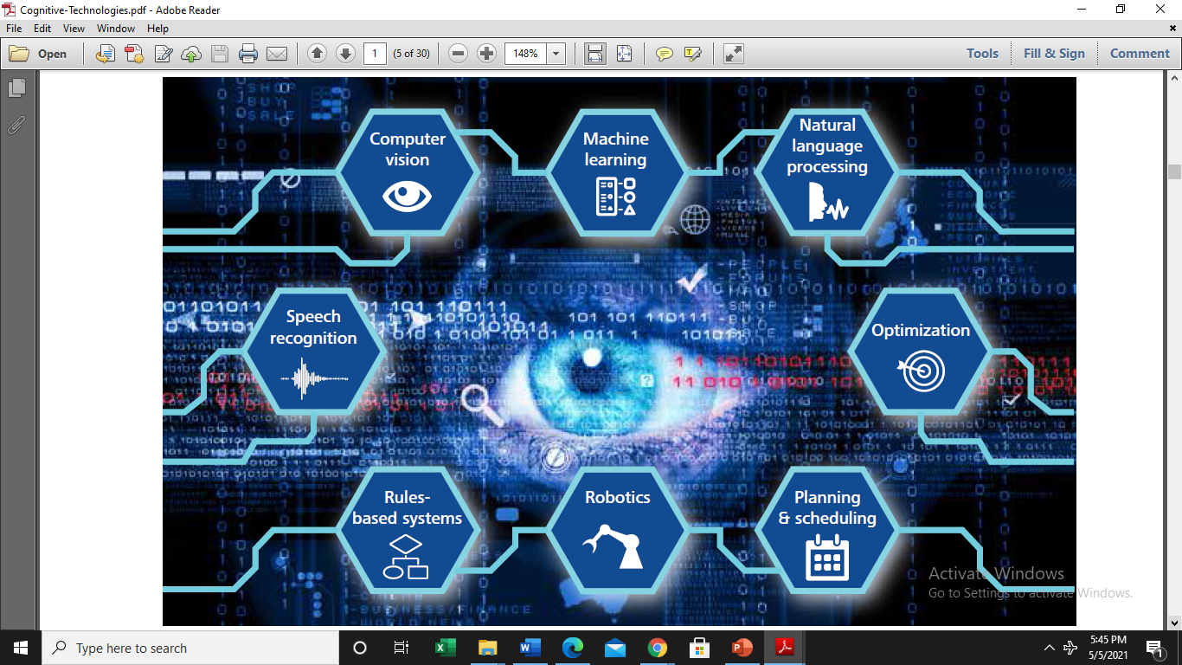
Contributing Technologies
Lecturer: T.Njoroge

Slide 18
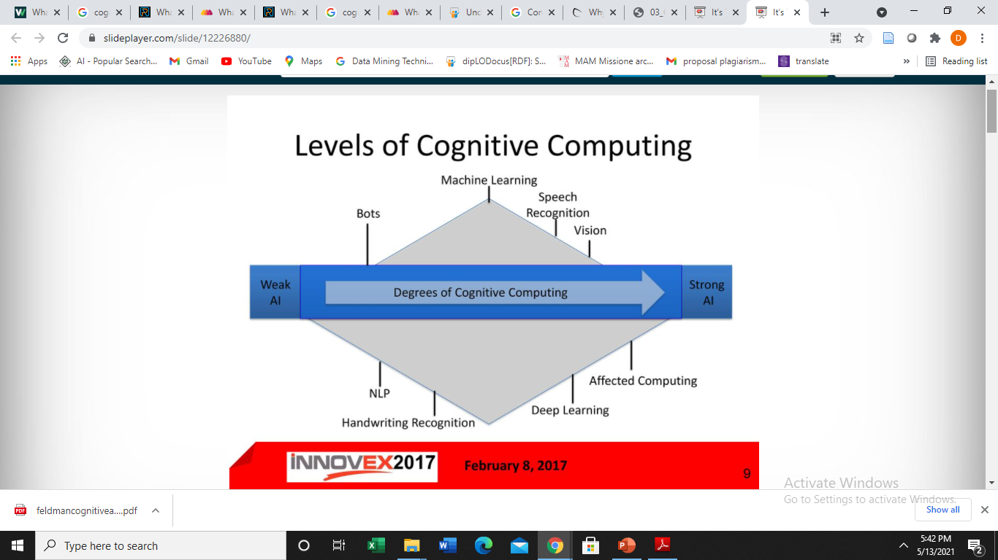
levels of Cognitive Computing
Low
High
Lecturer: T.Njoroge

Slide 19
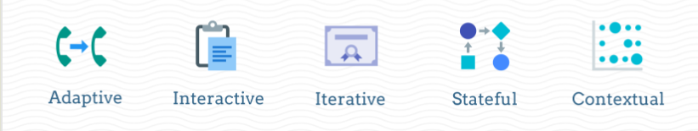
Features of Cognitive Computing Systems
There are five main features for the Cognitive computing systems
NB: Missing any of these attributes prevents a system from achieving cognitive computing.
Lecturer: T.Njoroge

